Slide 1
Introduction to Machine Learning
CS3300 Data Science

Slide 2
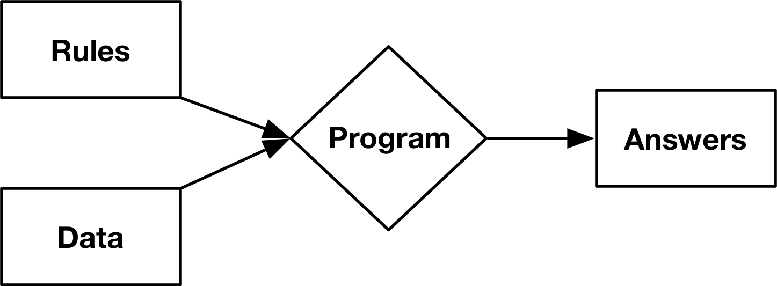
Traditional Programming

Slide 3
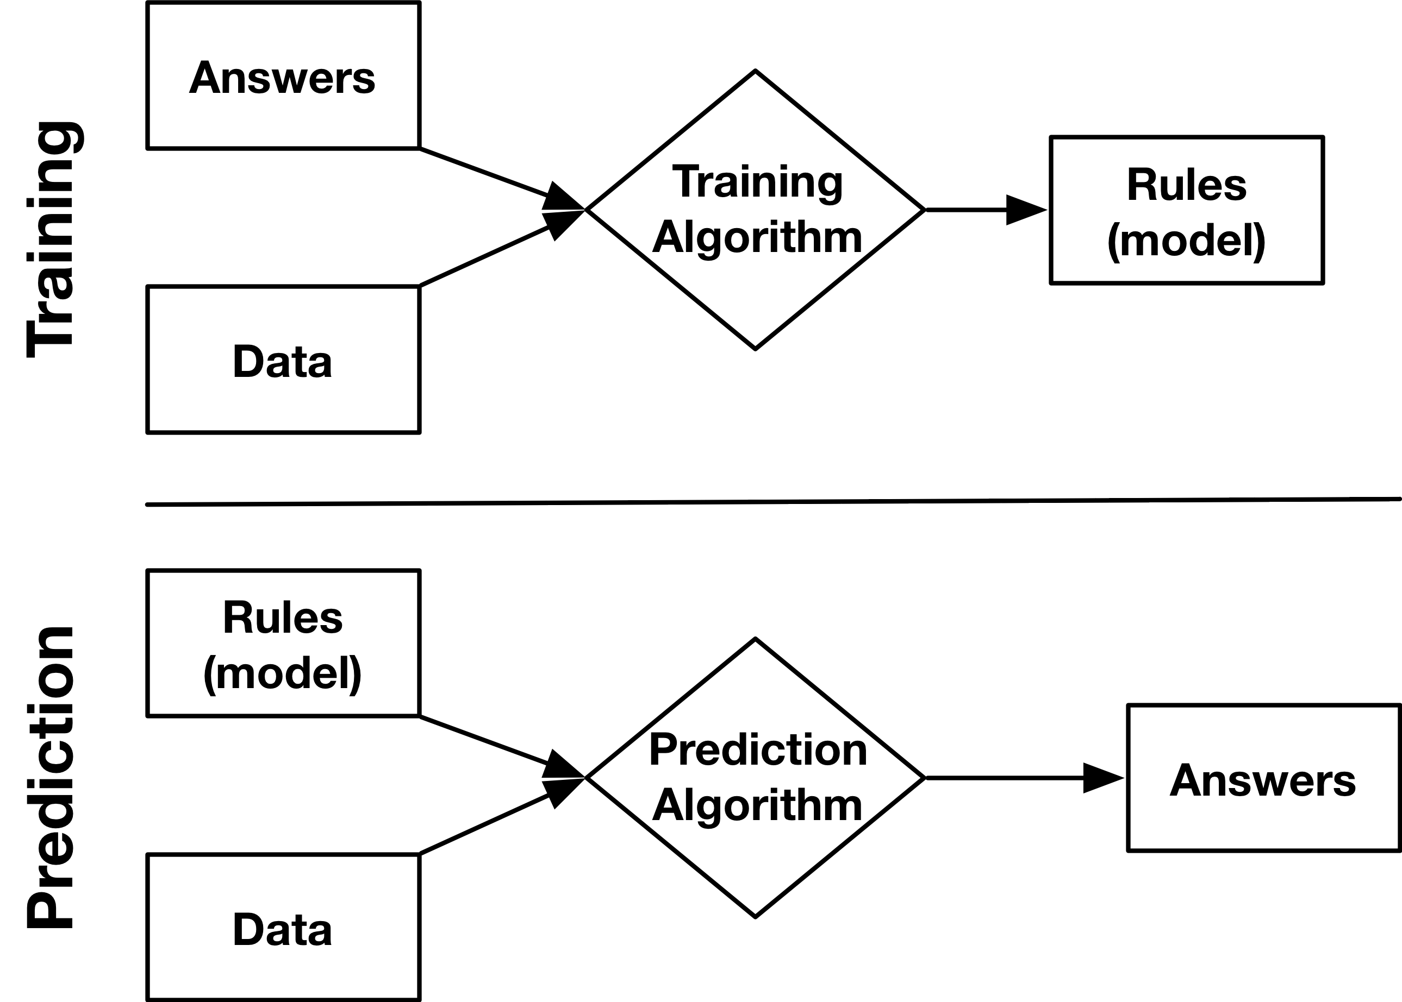
Machine Learning

Slide 4
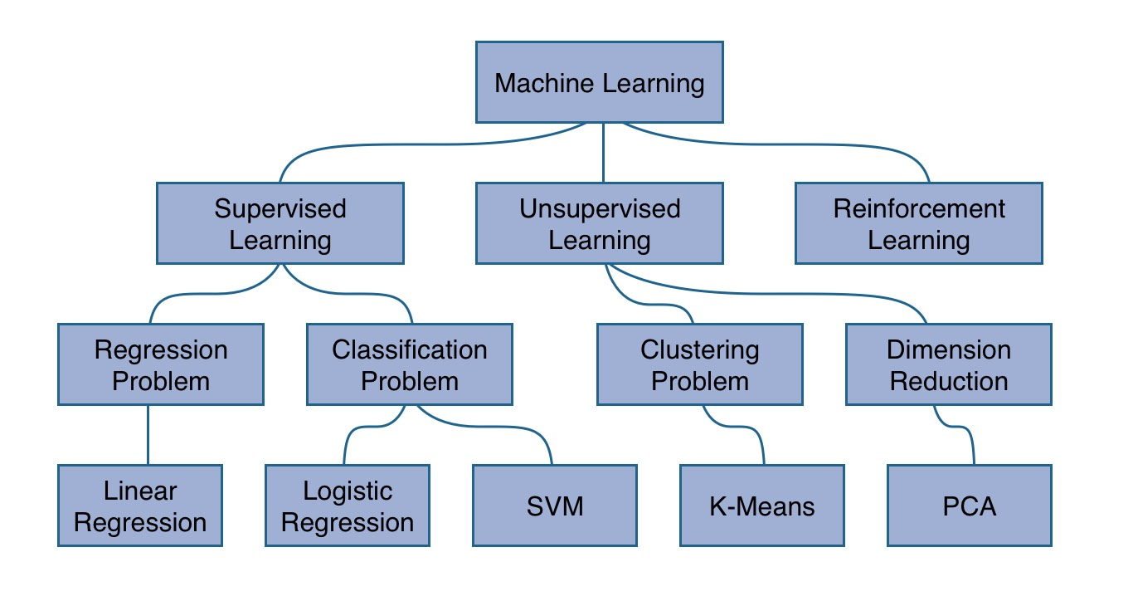
Machine Learning
https://www.robinwieruch.de/machine-learning-javascript-web-developers/

Slide 5
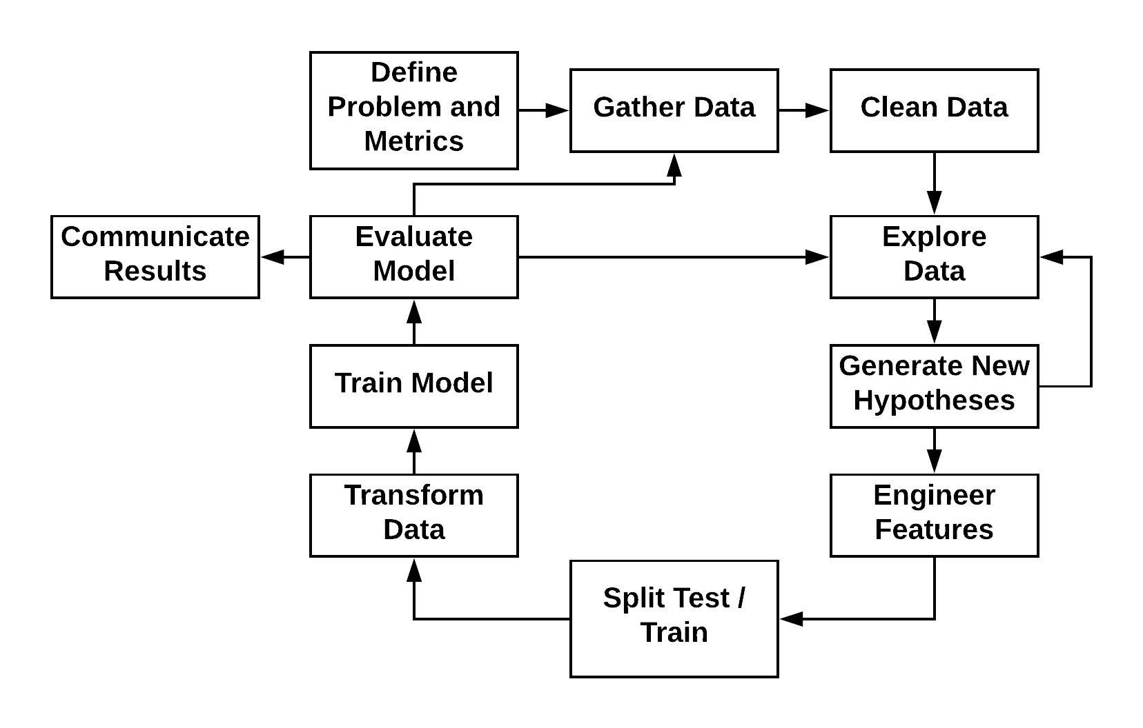
Machine Learning Process

Slide 6
Feature Engineering
Machine learning algorithms expect a matrix of variables
Variables called features
Feature engineering is the process of creating features from our data
Numerical representations of variables
Create new features from existing variables

Slide 7
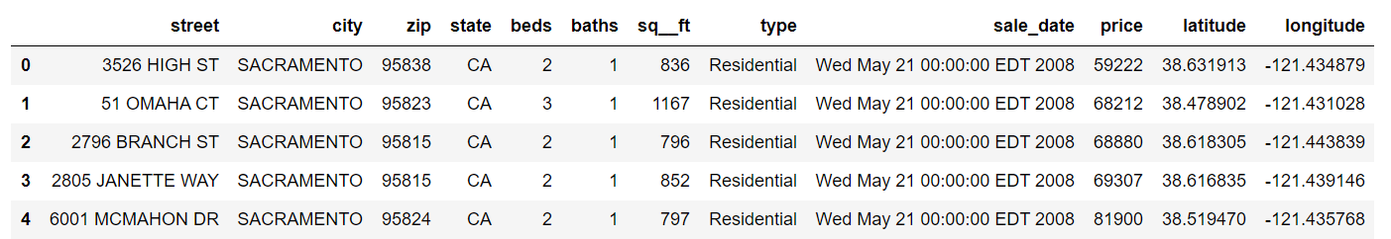
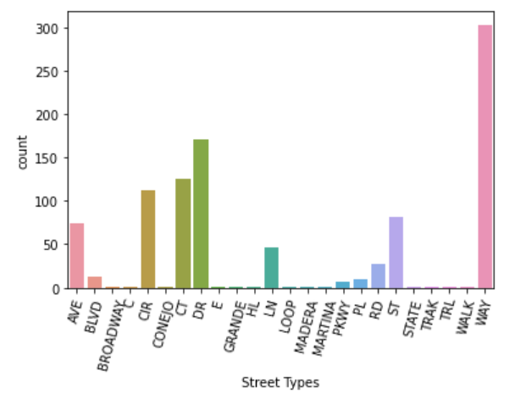
Feature Engineering Example

Slide 8
Feature Engineering Example
Dear Class, I've uploaded the new homework to D2L. It's due on Monday. I'm looking forward to seeing your solutions! RJ
?
[0, 1, 0, 0, 0, 1, 1, 0, 0]

Slide 9
Unsupervised Machine Learning
Used when you have data that does not have an output variable
Often used in an exploratory setting to identify relationships between samples or patterns in the data
Common approaches include:
Dimensionality Reduction – reducing the number of variables by grouping variables
Clustering – grouping samples into a discrete set of clusters

Slide 10
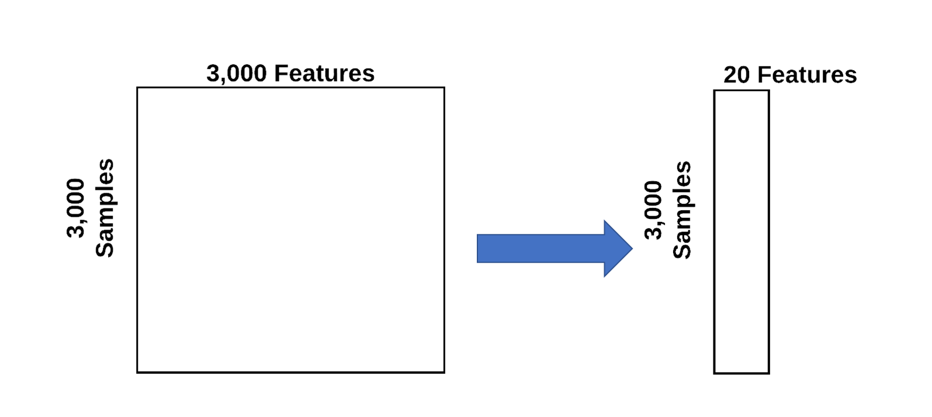
Dimensionality Reduction
Removing irrelevant features prior to model fitting
Features with poor correlation to response variable
Features that lack qualitative reason for impacting response variable
Reducing and condensing the number of features that we have to a more powerful and concise representations.

Slide 11
Common Dimensionality Reduction Algorithms
(Linear) Matrix Factorization Methods
Principal Component Analysis (PCA)
Non-Negative Matrix Factorization (NMF)
t-Distributed Stochastic Neighbor Embedding (t-SNE)
Uniform Manifold Approximate Projection (UMAP)
Variational Auto-Encoders (VAEs)

Slide 12
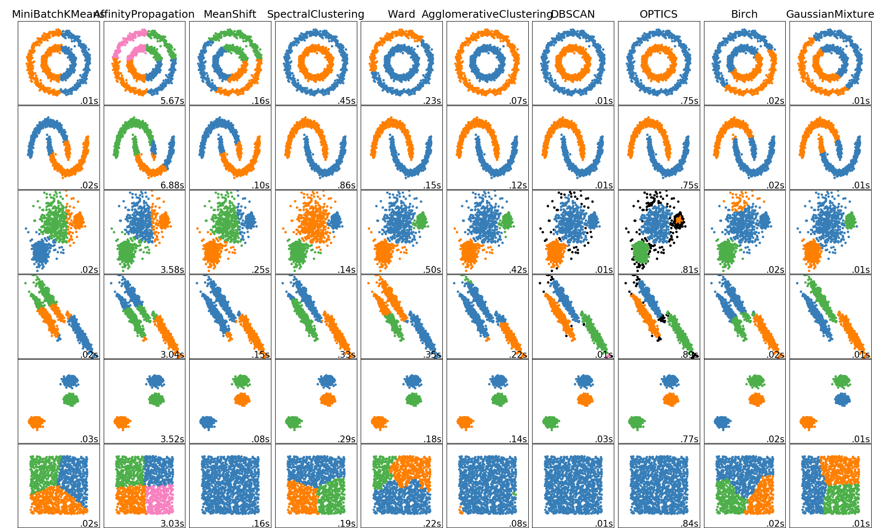
Clustering
https://scikit-learn.org/stable/modules/clustering.html

Slide 13
Common Clustering Algorithms
k-Means
k-Medoids
Ward's Hierarchical Clustering
Gaussian Mixture Models
DBSCAN
Spectral Clustering

Slide 14
Supervised Machine Learning
Supervised
We are trying to predict the values of a variable
We train the model using samples with known values
We apply the model to samples for which the value is not known
Classification -- predict a categorical value
Does the picture contain a cat or a dog?
Regression -- predict a continuous value
How much money will the house sell for?

Slide 15
Common Regression Algorithms
Linear Regression
Polynomial Regression
Multivariate Adaptive Regression Splines (MARS)
k-Nearest Neighbors (kNN) Regression
Random Forest Regression
Neural Network Regression

Slide 16
Common Classification Algorithms
Logistic Regression
k-Nearest Neighbors (kNN)
Random Forests
Support Vector Machines (SVMs)
Naïve Bayes
Neural Networks

Slide 17
Evaluation
We evaluate models by comparing predictions to known values
We use metrics to quantify the amount of error
The choice of metric depends on:
The type of machine learning problem (e.g., classification or regression)
Whether some types of errors are more important than others

Slide 18
Scikit-Learn
Popular Python library for machine learning
One of the most widely used for machine learning, period
Key innovations:
High quality software with regular releases
Includes a large array of algorithms – hard to find something missing!
Great user documentation
Fit nearly all models into a unified API
http://scikit-learn.org/stable/user_guide.html

